Slide 1
Natural recursion
The recursion happens where the data is put together
the natural place for it
recurses on sub-part of data → clear it will always terminate
LOX is one of:
empty
(cons X LOX)
(cons 1 (cons 2 (cons 3 … empty
(define (foo lox) (cond [(empty? lox) base]
[else
(fn (first lox) (fn-for-lox (rest lox))]))
(fn 1 (fn-for-lox (cons 2 (cons 3 … empty

Slide 2
Generative recursion
The “non-natural” superset of natural recursion
Recurses on new data → potentially does not terminate
(define (genrec-fn d)
(cond [(trivial? d) (trivial-answer d)]
[else
(... d
(genrec-fn (next-problem d)))]))

Slide 3
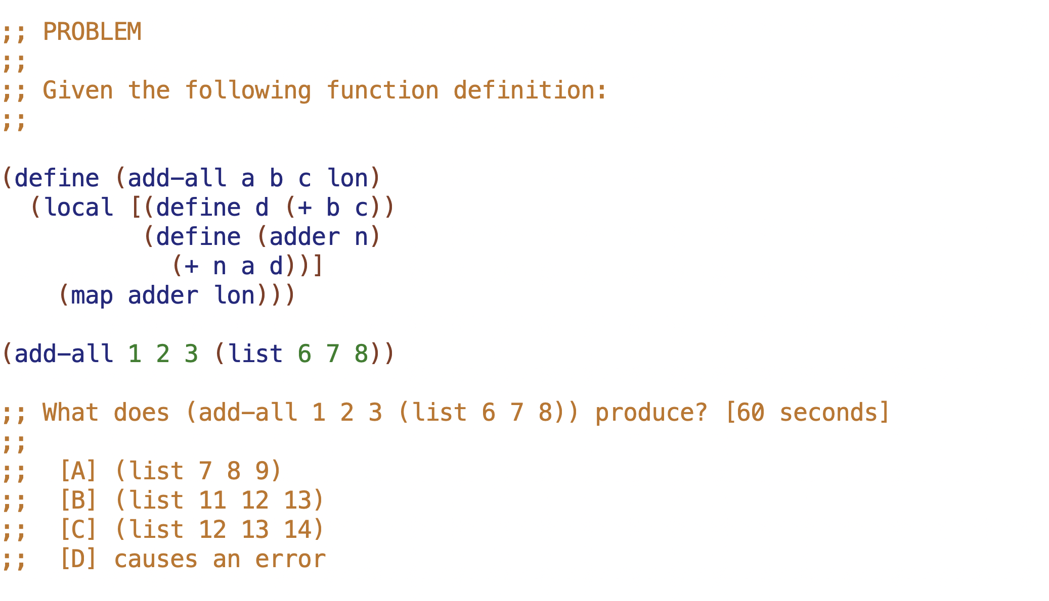
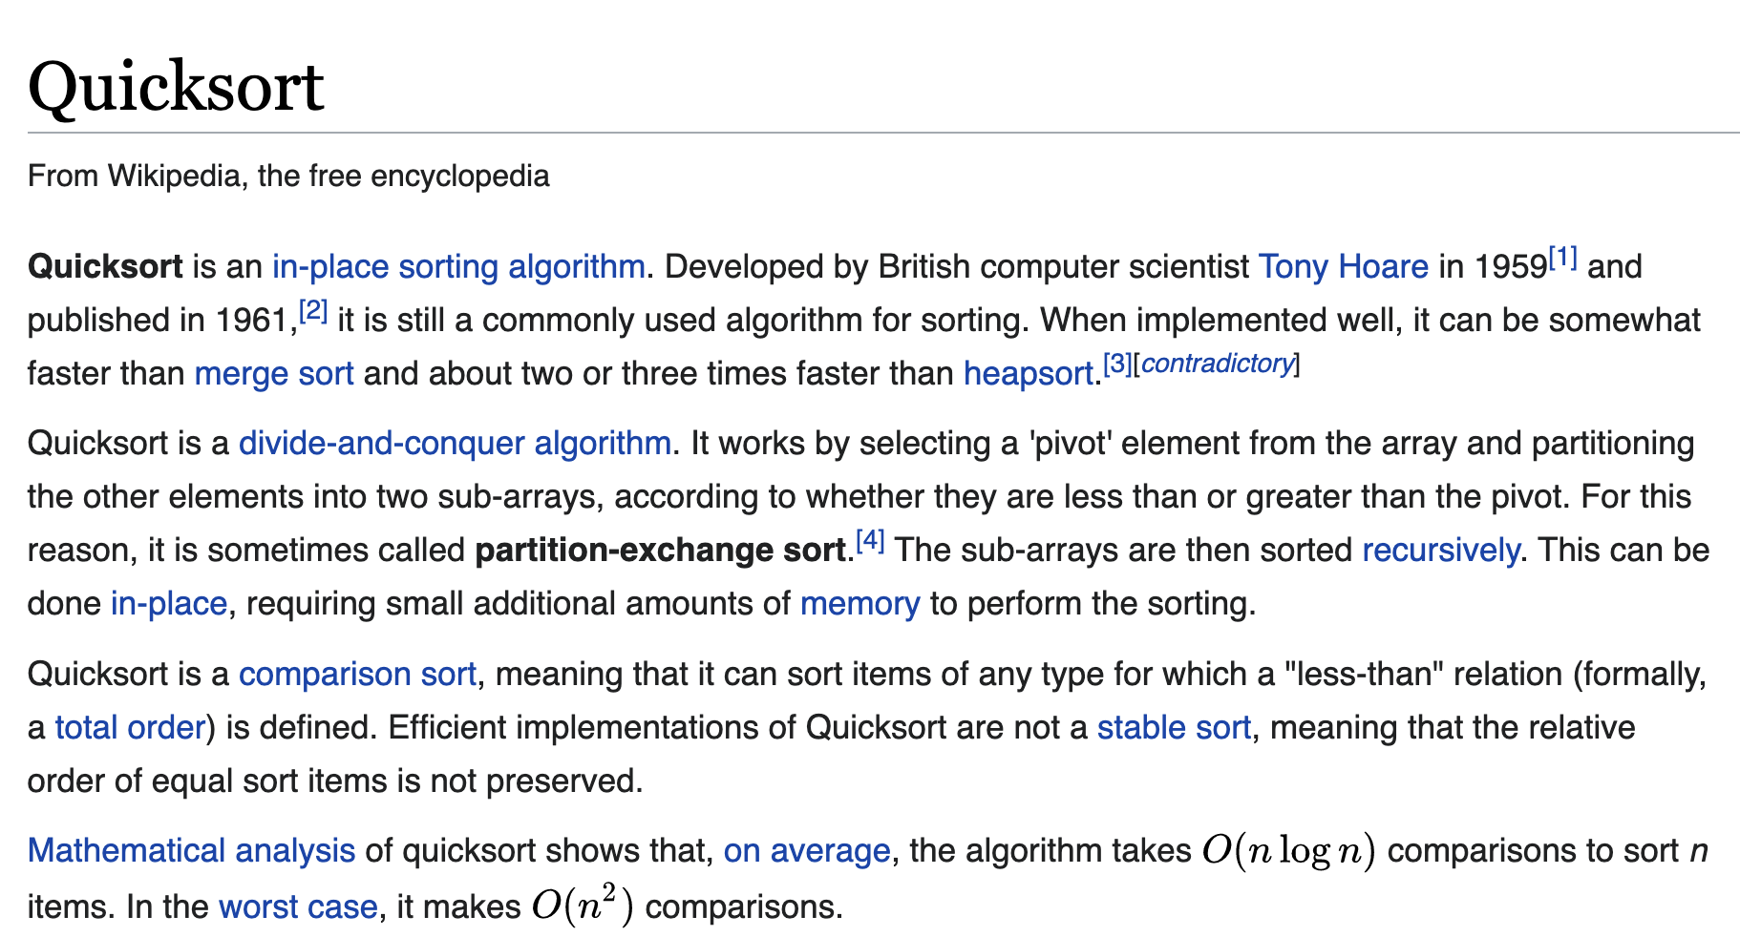

Slide 4
(list 6 8 1 9 3 7 2)

Slide 5
(list 6 8 1 9 3 7 2)
6
(list 1 3 2)
(list 8 9 7 )
1
(list 3 2)
(list)
3
(list 2)
(list)
2
(list) (list)

Slide 6
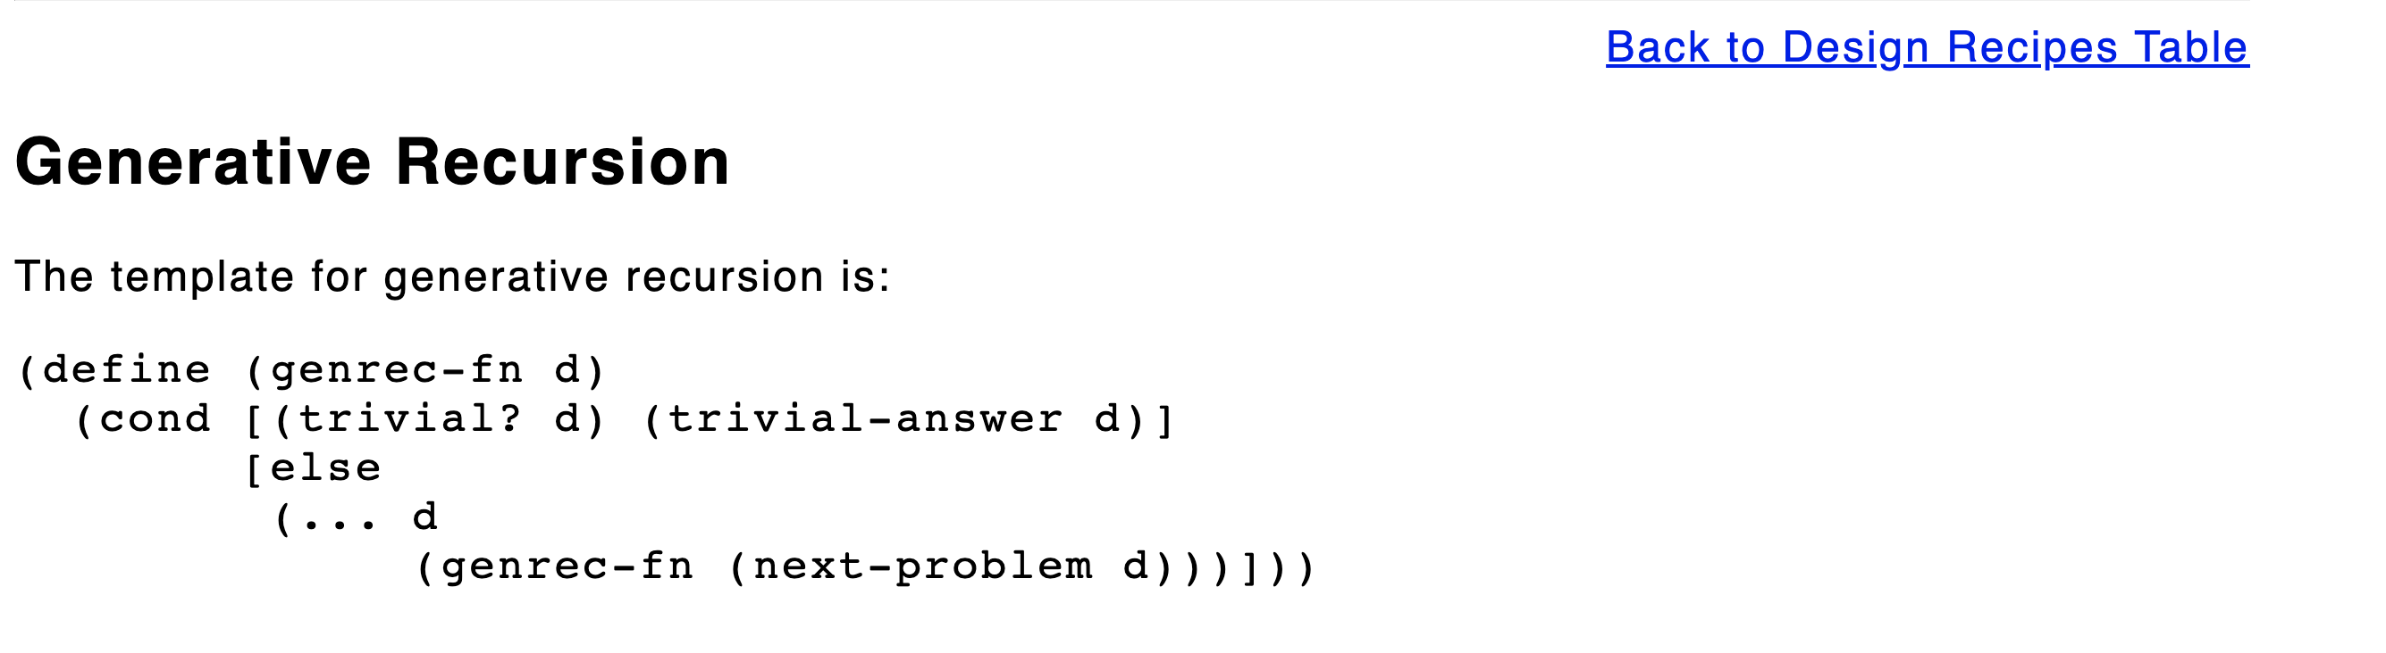

Slide 7
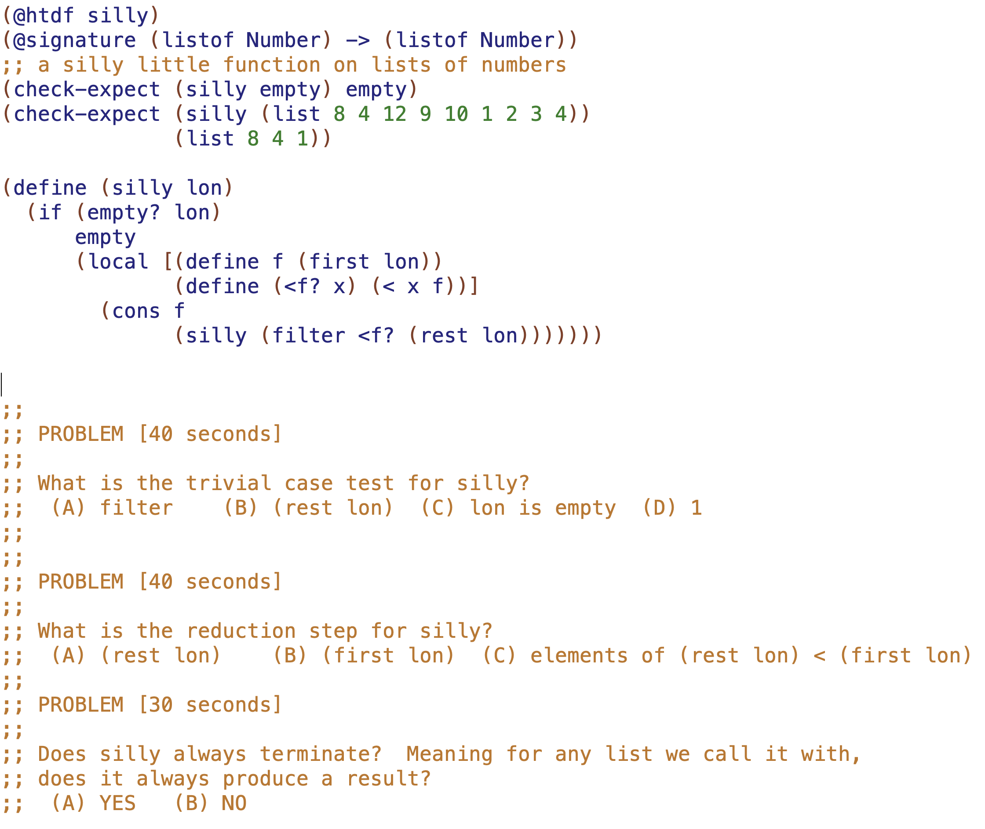

Slide 8
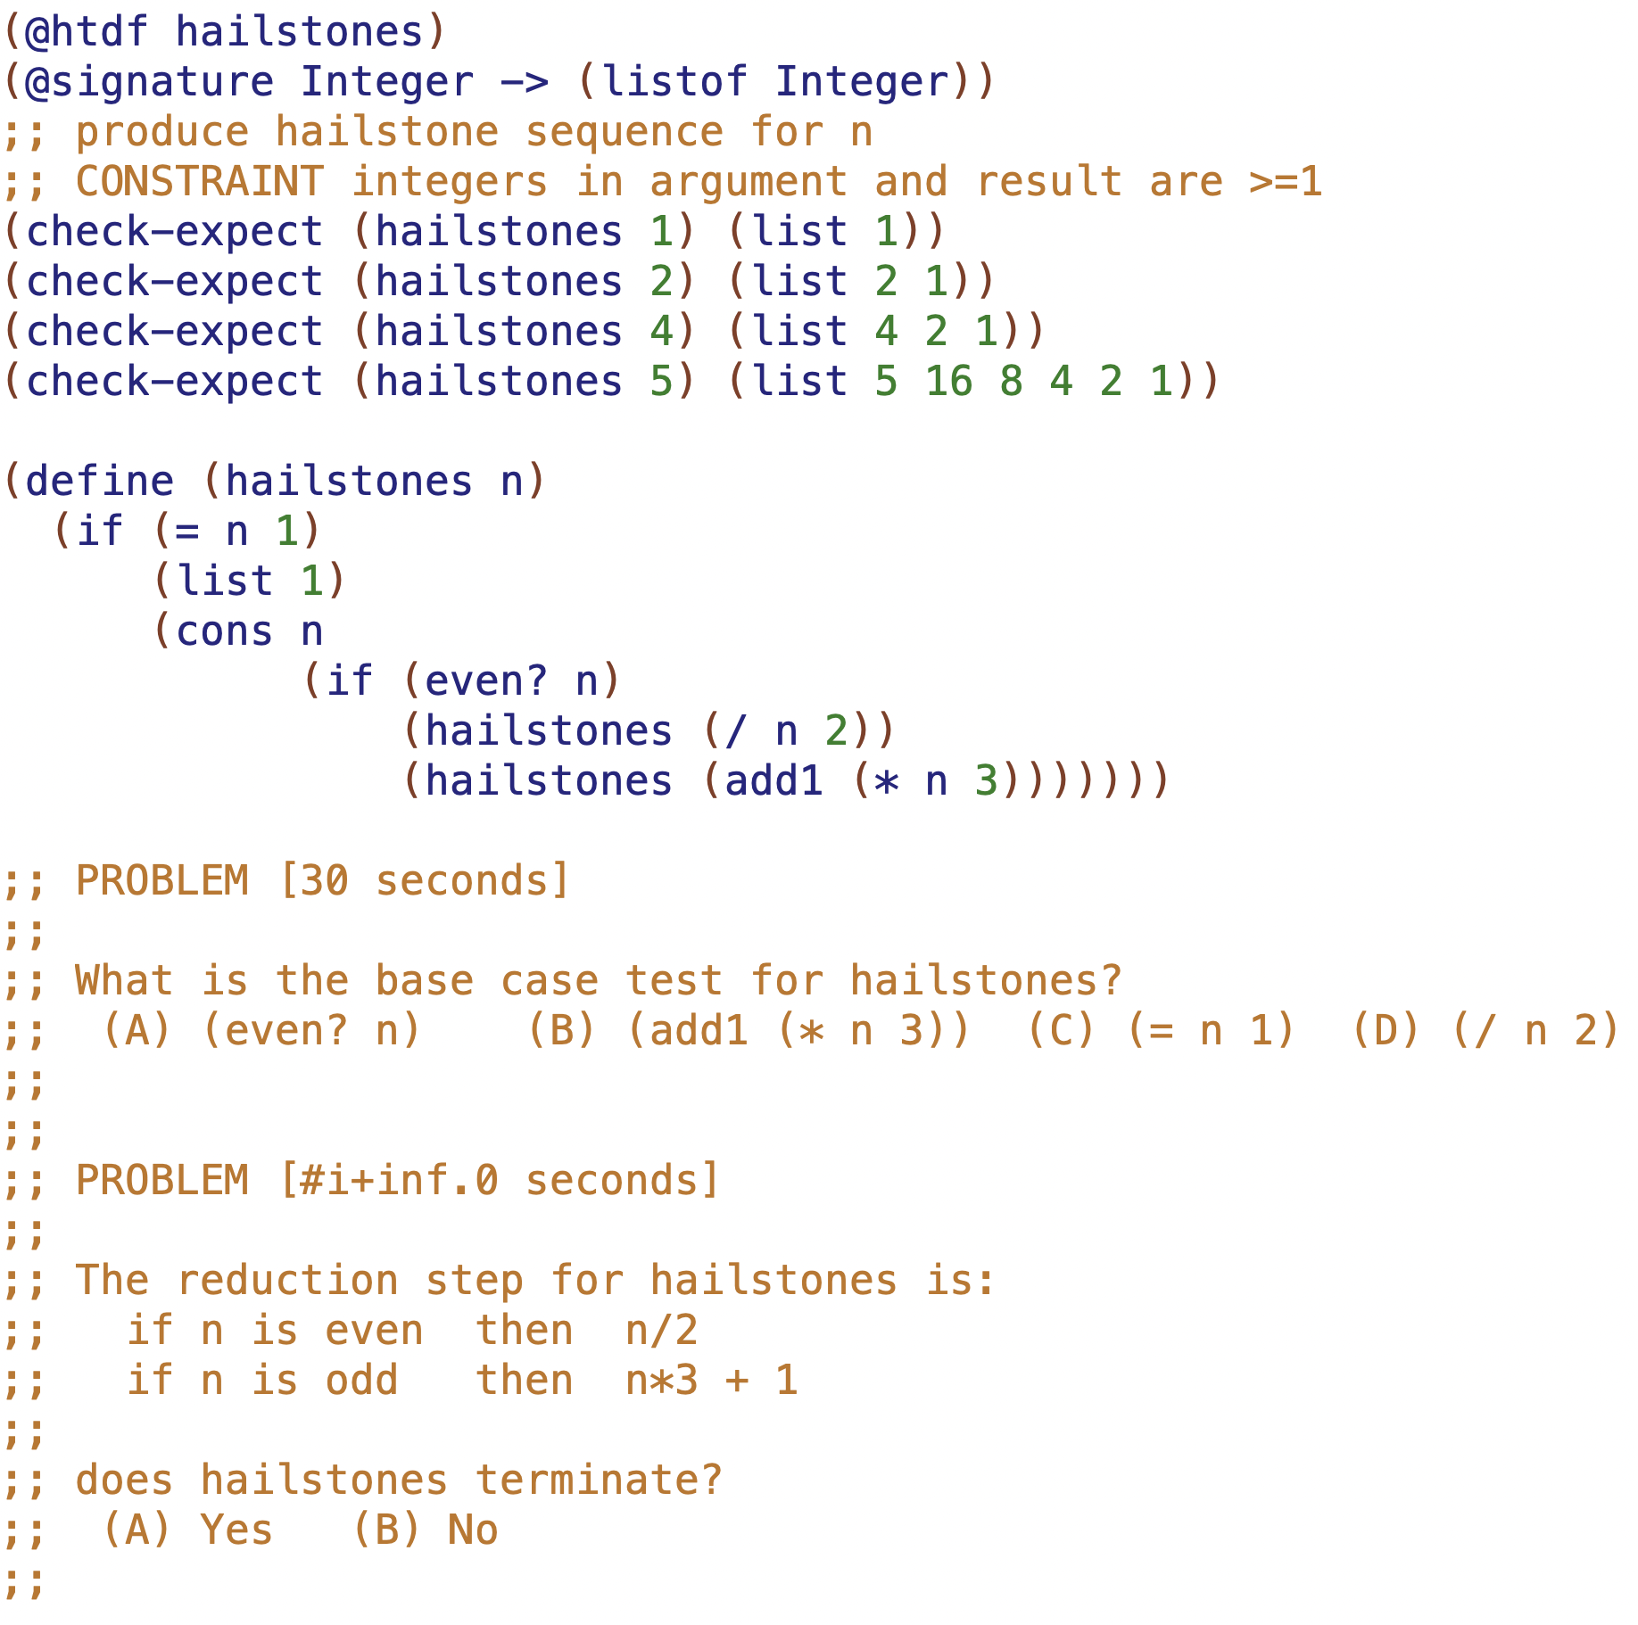

Slide 9
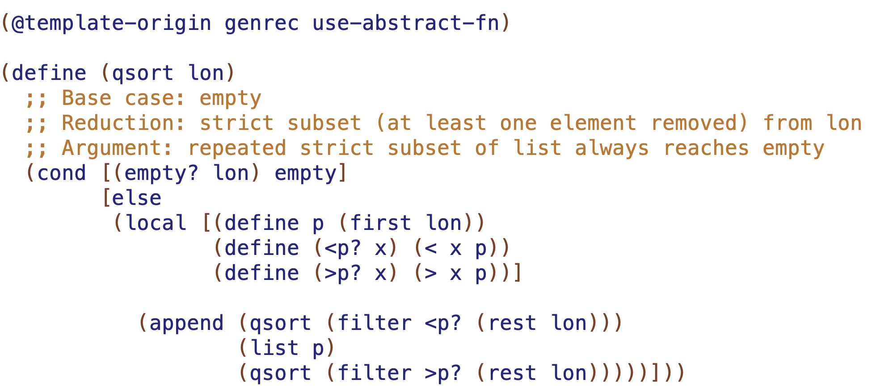

Slide 10
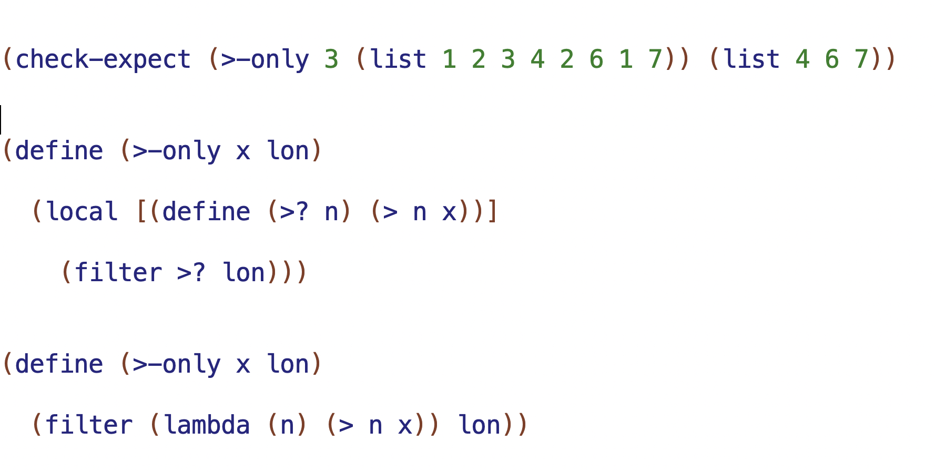
define a function called >?
it has one parameter n
and here’s the body
make an anonymous (nameless) function

Slide 11
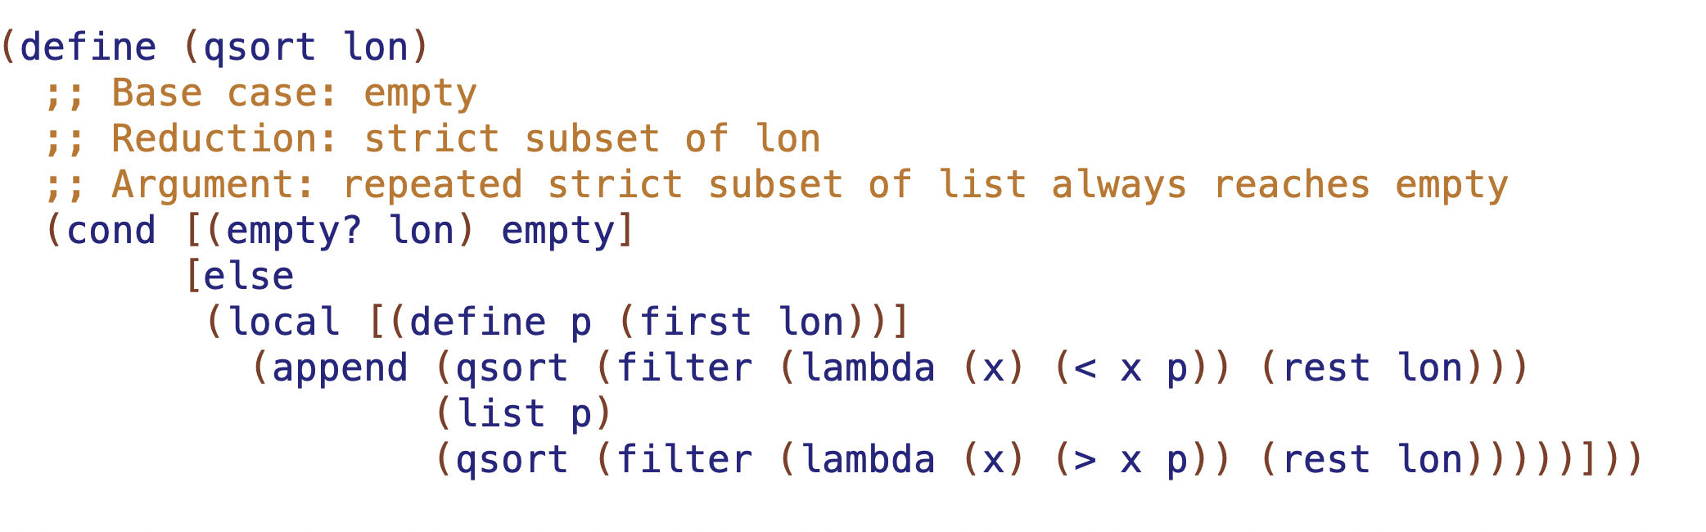

Slide 12
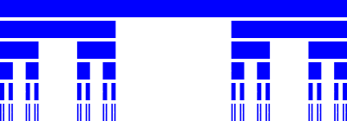

Slide 15
